Slide 1
Cassidy Buescher Site Visits – Spring 2016

Slide 2
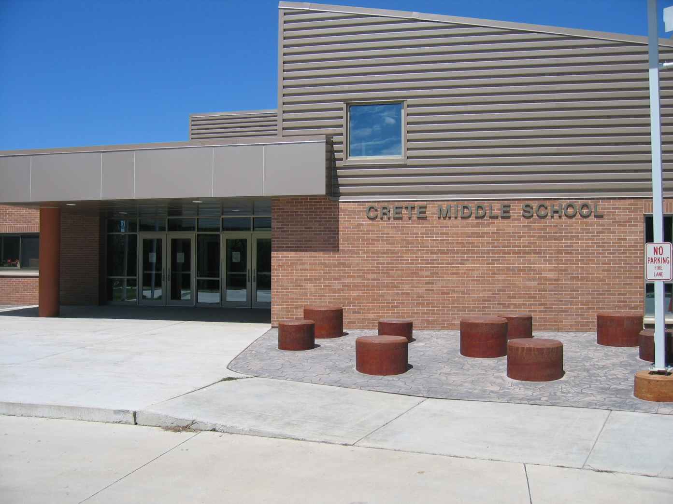
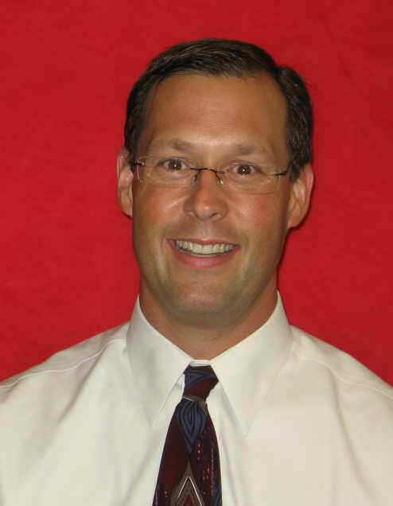
Visit #1 – Crete Middle School
Steve Teget
-Principal

Slide 3
The day included:
Shadowing the principal of the middle school, Mr. Steve Teget, for a full school day.
-Daily duties
-Parent interruptions
-Tours of the new facilities
-Classroom and teacher observations
-A budget meeting and behavior intervention meeting

Slide 4
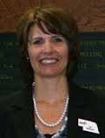
Visit #2 – ESU 4 Professional Development Presentation
Jen Madison
Suzanne Whistler

Slide 5
The day included:
Shadowing Jen and Suzanne as they presented to staff at Syracuse High School
Set-up, scheduling, and clean-up
A few questions here and there with Syracuse staff and administration
An interview and discussion

Slide 6
Big Picture:
My goal was to receive a wide range of experience, knowledge, and questions to ponder with my two visits, and I feel like I achieved that goal.
All in all, I was witness to each and every type of leadership discussed in our program outcomes.

Slide 7
Strategic Leadership
1.1(Consistent Philosophy of education) and 1.2 (Develops vision and purpose)
Crete Middle School has a clear philosophy of education that involves positive reinforcement.
The theme “Every Student is a STAR” is seen consistently throughout the building.
STAR= Show integrity, Through respect And Responsibility

Slide 8
Strategic Leadership cont…
The school’s mission and goals are posted right in the entrance along with stars everywhere.
There is a “Stellar Students” trophy case in the entryway.

Slide 9
Strategic Leadership cont…
1.6 (Engages in problem solving techniques and decision making skills.)
From the very start of the day, which was filled with interruptions, meetings gone late, phone calls, and student issues, I was able to observe Mr. Teget solving each problem that arose.
Each decision that had to be made was determined based on what was best for the students.

Slide 10
Strategic Leadership cont…
1.8 (Provides assessment of people, programs, plans, processes, and products.)
Mr. Teget discussed with me some of their procedures for behavior plans and ISS plans. He and the counselor, even as we discussed, were evaluating the effectiveness of these plans.
For example: what works are “The Scoop” sheets student have to fill out if they are removed from class stating in their own words what they did wrong, the 3 step procedure for classroom safe seat, team safe seat, and ISS, and the ISS assignment protocol.
The procedure doesn’t work, however, if the behavior is out of control before the first step is activated.

Slide 11
Instructional Leadership
2.3 (Promotes effective teaching and learning styles)
Obviously, Suzanne and Jen do this every day.
It was fascinating to consider professional development from a leadership perspective and consider teaching teachers as a leadership activity.

Slide 12
Instructional Leadership cont…
Jen and Suzanne modeled strategies in their own presentation they would use for middle and high school students and made that clear to the staff.
They made the connection to their school improvement goal clear and made it relevant to each and every teacher.

Slide 13
Instructional Leadership cont…
Learning points from our discussion:
Dealing with resistance from teachers is possible. Acknowledge points of view, make the content relevant, and “Don’t show your underwear!” (Be self-assured and deal with problems that arise with confidence.)
Teaching adults is often very much like teaching kids, except there are no chances for do-overs since it’s only one day. Developing relationships are just as important, just in a different way.

Slide 14
Instructional Leadership cont…
Their toughest struggles include:
Follow-up. It’s difficult to make time to ensure that their strategies are being implemented and what the results are.
Time constraints. They have to determine what’s important and make time for modeling and reflection among teachers.

Slide 15
Instructional Leadership cont…
2.6 (Utilizes teacher supervision and evaluation to influence teaching and learning.)
In Crete, I was able to watch as Mr. Teget observed and evaluated a teacher in the science classroom. The teacher was fantastic and Mr. Teget’s evaluation made it clear that they were on the same page as far as expectations, and it was no surprise to either that his evaluation was positive. Both the observation of the teacher and the completed evaluation were excellent learning opportunities for me.

Slide 16
Organizational Leadership
3.5-3.6 (Identifies and analyzes sources of fiscal resources and understands budget planning and implementation processes.)
I attended a budget meeting with Mr. Teget focused on allotting funds and creating budget plans for the new facility (turning 3 buildings into 4).

Slide 17
Organizational Leadership cont…
Points of interest from that meeting include:
Working with an administration team vs. working alone. (My principal in a small school makes most of his budget decisions on his own. Working with APs, Ads, Curriculum Directors, and other principals was a new experience.)
Problems with creating a separate intermediate school that I wouldn’t have considered, like creating a new library, gaining new technology, etc. essentially, working with a shared budget but not gaining extra funds for additional items.

Slide 18
Organizational Leadership cont…
3.2 -3.3 (Understands policies providing for safety, health and welfare, and applies a systems perspective, viewing schools as open structures.)
Mr. Teget took me on a tour of the new high school facility. In doing so, he explained some of the process that went into working with the BOE, and planning for health and safety systems in the new facilities. I was also able to tour the remodel in process of what will be the new middle school, and Mr. Teget explained some of the issues that have arisen that were not planned for.

Slide 19
Organizational Leadership cont…
3.4 (Understands processes for the recruitment and induction of personnel with attention to equity and diversity.)
Mr. Teget is a fluent Spanish speaker. Understanding the needs of his community, the personnel working in the offices speak Spanish as well. We discussed the hiring of teachers. He explained that while speaking Spanish is not a requirement, if he is choosing between 2 equal candidates, a Spanish speaker would likely be chosen to fit those school community needs.

Slide 20
Community/Political Leadership
4.1 (Addresses conditions affecting learning by developing relationships with community agencies.)
Mr. Teget expressed concern for a few students who were involved in inappropriate activities in the community. He understands his community and works with agencies that help these students.
The school recently earned a grant to help them hire a school resource officer who works closely with the police department and has provided the administration with an invaluable connection between the school and community.

Slide 21
Community/Political Leadership cont…
4.2 (Promotes multicultural awareness)
Crete Middle School has many programs that promote cultural awareness and acceptance. They work hard to create a community of learners that are sensitive to diversity.
A student complained of being called a racial slur, and the problem was dealt with in a matter of moments, student reprimanded, parents contacted, and incident logged. It is clear that students and staff alike know that such behavior is not to be tolerated.

Slide 22
Community/Political Leadership cont…
4.7 (Demonstrates sensitivity, respect, and empathy for multiple perspectives.)
Mr. Teget had several parent contacts throughout the day, but one in particular stood out as an excellent example of collaborating with parents:
The mother of a student mentioned earlier in the day who had inappropriate connections in the community came in and requested a meeting with Mr. Teget. He sat down with her (dropping everything he was in the middle of) and listened carefully to her concerns (in Spanish). He then aided her in her request to search her daughter’s locker. Throughout the parent contact, he was positive, understanding, and helpful. She clearly felt comfortable expressing her concerns to him, and he made her feel comfortable sharing information that might help her daughter grow, learn, and change. Even though I understood only half of the words, I understood all of the compassion.

Slide 23
Overall…
I feel as though I learned a great deal about school leadership through my site visits.
It is clear to me that the mentorship of great leaders is crucial to help me develop my own leadership skills, and I hope to continue to build relationships that help me grow and learn.

